Slide 1
Drawing angles
Ms. Latham
Year 7

Slide 2
Learning Intentions
Students will be able to
Practise using the protractor
Draw angles to accuracy of 3 degrees
Read angels with an accuracy of 3 degrees

Slide 3
Review!
Students will be called on to fill in the table so be ready!
Angle Type | Right | Obtuse | Straight | Acute | Reflex | Revolution
Definition
Image
Notes:
Assign a section for each group/pair to discuss with their partners then go up to the board to fill in the blanks. Make sure the WHOLE class agrees before moving on.

Slide 4
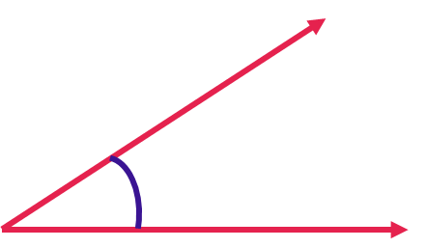
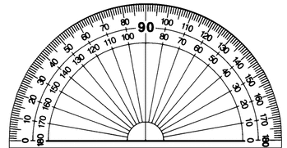
24
7
30
Topic: Drawing Angles
Date:
EQ –How do I draw angles?
How to measure angles?
Step 1: Line up the bottom of the angle with the straight line of the protractor.
REVIEW from yesterday DO NOT write down!

Slide 5
24
7
30
Topic: Drawing Angles
Date:
EQ – How do I draw angles?
How to measure angles?
Step 2: Measure from the bottom arm to the top arm of the angle
Make sure the vertex is lined up with the middle of the protractor
REVIEW from yesterday DO NOT write down!

Slide 6
24
7
30
Topic: Drawing Angles
Date:
EQ – How do I draw angles?
How to measure angles?
Step 3: Read the protractor = 31°
REVIEW from yesterday DO NOT write down!
We are going to do a similar process for drawing angles!

Slide 7
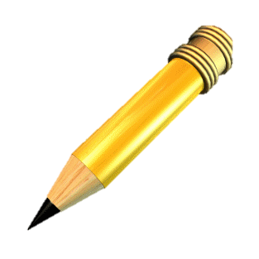
24
7
30
Topic: Drawing Angles
Date:
EQ – How do I draw angles?
How to draw angles?
Step 1: Draw a straight line (you can use a ruler or the bottom of your protractor)

Slide 8
24
7
30
Topic: Drawing Angles
Date:
EQ – How do I draw angles?
How to draw angles?
Step 2: Choose where the vertex will be
A
B

Slide 9
24
7
30
Topic: Drawing Angles
Date:
EQ – How do I draw angles?
How to draw angles?
Step 3: Dot to dot - line up the centre of the protractor with the vertex

Slide 10
24
7
30
Topic: Drawing Angles
Date:
EQ – How do I draw angles?
How to draw angles?
Step 4: Line to line - line up the straight line with the 0°

Slide 11
24
7
30
Topic: Drawing Angles
Date:
EQ – How do I draw angles?
How to draw angles?
Step 5: You read the numbers starting from 0° (where the straight line is) and moving away from 0° until you reach the degree you want and mark with a small dot.
30°

Slide 12
24
7
30
Topic: Drawing Angles
Date:
EQ – How do I draw angles?
How to draw angles?
Step 6: Connect the vertex to the dot
Step 7: Put arrows at the end of the lines
30°

Slide 13

Everyone needs a protractor and a piece of coloured paper.
Send ONE person from each group up to collect the materials.

Slide 14
Guided Practice
Draw these on your left hand side!
Step 1: Draw a straight line
Step 2 : choose where the vertex will be
Step 3: dot to dot
Step 4: line to line
Step 5: Place a dot on the degree
Step 6: Connect the vertex to the dot
Step 7: Put arrows on the end
Notes:
Draw 3-4 angles on the board going through each step.

Slide 15


Partner Paired Practice
Draw two angles on your card
Try to be as accurate as you can be! Help each other
Draw
Pass
Try
Pass the angles to your partner to solve
Complete your summaries!
If you finish early! Keep going making harder and harder ones!
Notes:
Have students glue the cards into their books.

